Slide 1
CAPEX Vilvoorde PMO
Draft 26/09/2024
Maike Speck

Slide 2
Reference material
Portfolio management -Guidelines and best practices
Project Management execution methodology
CFB PMO Community of Practice -Gate reviews

Slide 3
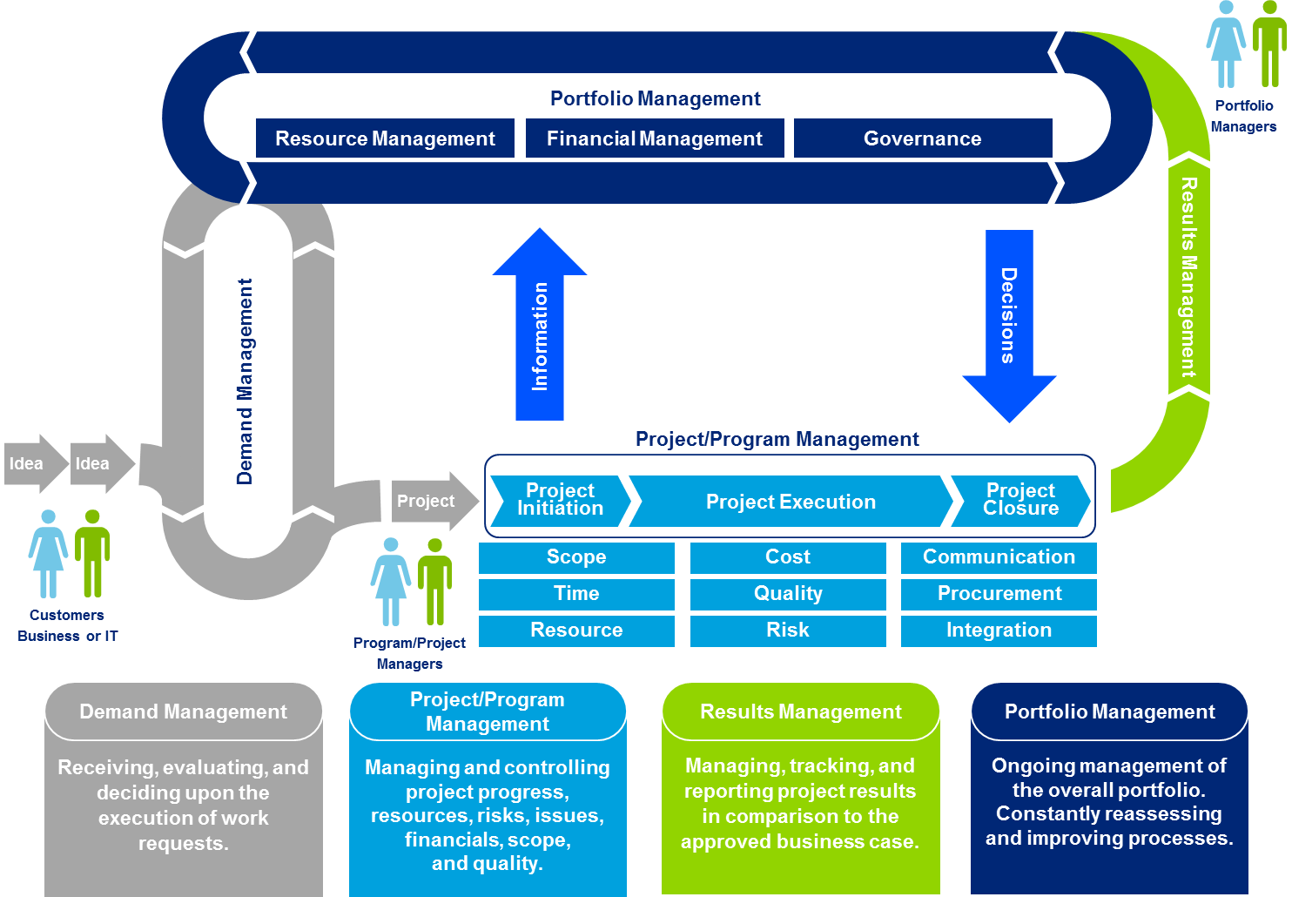
PPM Capability Framework
Portfolio and Project Management (PPM) Overview
This capability framework shows how the PPM processes and PPM sub-process intersect
5
© 2021 Cargill, Incorporated. All rights reserved.
3

Slide 4
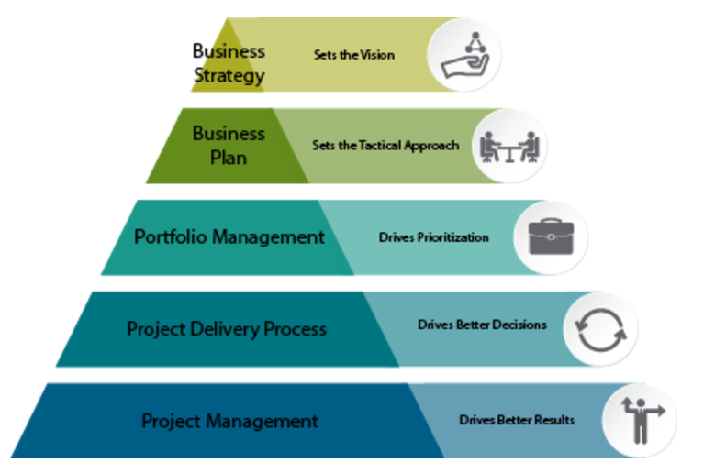
Cargill PPM Process

Slide 5
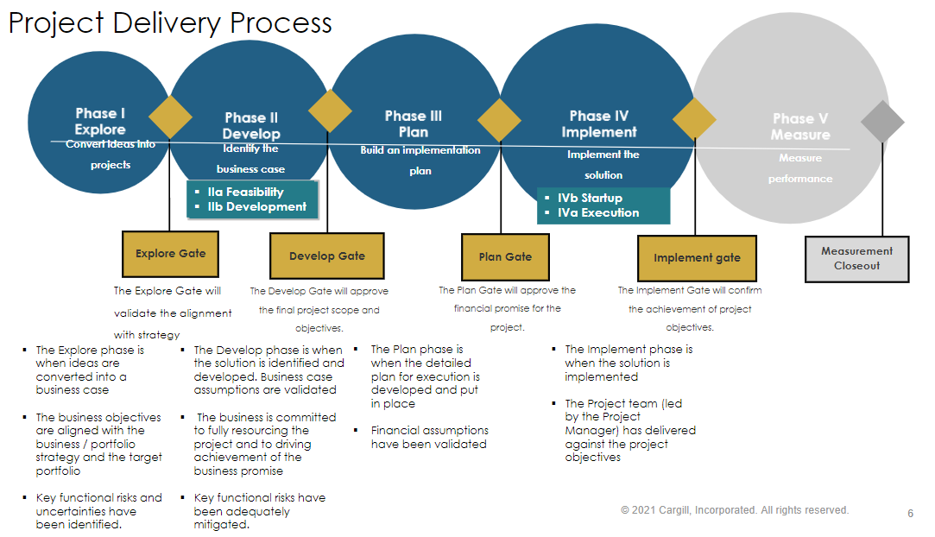
PDP

Slide 6
Roles & Responsibilities
Project Team
Technical Review team
The Review Team approves selected solution and confirms quality
A Gate Review Team (GRT) is a group of unbiased people who are involved in the formal review of the project status and evaluation of readiness to proceed to the next phase.
Project has optimum solution and frozen the scope.
Technical risks are understood and managed
All deliverables are complete and meet the required level of quality
Gate Approval team
The Project team selects the best solution and completes deliverables for each phase
Team Composition:
Portfolio owner
Financial lead
>500K: Global Eng &Data Sc Lead
<500K: Local Op& Eng lead
Team Composition:
PM, Sponsor, BPM,
Functional Leads
Steering committee
A Steering Committee is usually a group of high-level stakeholders who are responsible for providing guidance/ strategy
Team composition:
R&D and business leaders
Check completeness of deliverables
Go/no go decision
Approve next phase (plan, budget and resources)
Coaching project sponsors and project managers
Team Composition:
SME’s
“The designated SME’s must be independent of the project team”

Slide 7
Vilvoorde review teams
Technical review (SMEs) | Plug&Play | Process equipment with engineering | Infrastructure
EHS SME | EHSVF0079 | ü | ü | Rik |  | ü | Power App Eng Plan
FS SME | if applicable | ü | ü | Vincent |  | ü | myPPM
EIA SME |  | ü | ü | Franz |  | ü | outside my PPM
Operations& Eng lead |  | ü | ü | Els
IT SME |  | if applicable | if applicable | Global IT
Gate Approval | Tactical | Strategic | Global R&D PRT | Names
 | 5 -100K | 100-500K | > 500K
Project manager (submit proposal) | ü | ü | ü
PMO (check process adherence) | ü | ü |  | Maike <500K, Global PRT > 500K
Approvers
Financial controller | ü | ü | ü | Xavier
Portfolio owner | ü | ü | ü | Els
Project Sponsor | ü | ü | ü
Build project manager |  | ü | ü
Global Fin R&D lead | ü | ü | ü | Joanne Hurst
Global R&D CAPEX process lead | ü | ü | ü | Susan Creek
R&D Leaders = Portfolio review team |  | ü | ü | VLT

Slide 8
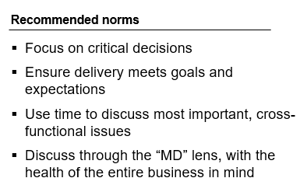
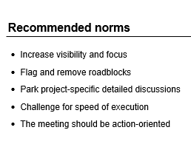
Meeting Cadence
 |  |  | Daily | Weekly | Monthly | Quarterly | Semi-Annual
Tier 5 Global LT
Tier 4 Local LT: Site Leadership
Tier 3 Area supervisors, PM, SME’s
Tier 2 Project team Functional teams
Tier 1 PM/BPM, contractors
Global R&D PRT
Operational Strategy review
Business CAPEX meeting (Escalation)
Portfolio Review Team (PRT=VLT)
Escalate
Issues/Info
Monthly CAPEX execution Meeting
Performance results review
Strategy Cascaded
Escalate
Issues/Info
Project team meeting / workstream meeting
Strategy Cascaded
Practical problem
Solving on –site
- Weekly Extruder
Weekly Choco Hub
Lower cadence for smaller projects
Technical alignment (SME)
escalation
-cooling table
-alarm devices fume hood
?
Notes:
Facilitator: [Jogchem]
This is Mandatory and nonnegotiable.
This is proven to work.
Performance Dialogues have two directions:
Cascading Strategy and Targets down
Escalating Issues up
1. Performance dialogues help to cascade group level KPI targets through different levels (Tiers) of the organization to the shopfloor level.
Every Tier is measuring performance in their own cadence
Every Tier is measuring performance with different BUT LINKED KPI’s
E.g. On Tier 4 we may measure OTIF (Monthly), in Tier 3 of Operations we follow PTP (Weekly), In Tier 2 we follow the SO Stability Index (Weekly) and at Tier 1 Real Time the Standard Operating Conditions (SOC)
2. If the team experiences issues with their workload or are not equipped to keep up with solving their problems this must be escalated up one level.
The level above must analyze why the team is escalating and whas must be changed to support the team
The level above should not start to do the job of the Tier below because this will most probably force them to escalate problems their own problems.

Slide 9
Monthly CAPEX Execution Meeting Agenda
60 min monthly meeting
Topics
Details
Timing
1
Safety
3-5 minutes
2
Action tracker
Review Action log
5 minutes
3
KPI’s
Financial dashboard
Gate review planning
10 minutes
4
Rapid, project-specific discussion
Ensure projects moving from
Identify areas for leadership support
Identify acceleration opportunities
Resources allocation
30 minutes
5
Pipeline review
Pipeline Overview
Present new projects
Project deep dive if needed
5-10 minutes (as needed)
6
Round table
Evaluate whether the meeting's objectives were achieved
3-5 minutes
© 2021 Cargill, Incorporated. All rights reserved.
9

Slide 10
Monthly CAPEX Execution Meeting
Participants (9 - ? ):
Maike (Facilitator)
Els (Budget owner)
Cynthia (Analyst)
Xavier (Finance)
Area managers (=PM):
Joel W
Ruben
Deepika
Bart
Dirk (representing Maint+ pilot?)
SME on need basis:
Franz EIA
Rik EHS
Vincent
overall_1_131963206030367274 columns_3_131963205524077529 23_1_131963205554809497 30_1_131963205555268266 45_1_131963205985246013 33_0_131963209999085449 55_0_131963209999115367 37_1_131963209883222330 50_1_132134010549806366 8_1_132134029278735661
meetings
12_84 26_84 55_85 45_89
Who’s in the room
Recommended norms
Project Managers =
Flags roadblocks
Focuses on getting work done (LSW)
SME’s
Solves or escalates roadblocks
Answers questions
Provide data to drive decisions
Share cross-department progress
flag roadblocks early
Park project-specific detailed discussions
Challenge each other on project valuations and timelines
The meeting should be action-oriented
Set priorities
Portfolio Budget owner (Els)
Set Priorities
Link to PRT’s
Department /Area managers
(Joel, Ruben, Dirk, Deepika , Bart)
Set Priorities
Challenge for speed of execution
Notes risks to escalate
Finance Tag (Xavier)
support and assists project managers with project valuation questions..
PMO (Maike)
Maintain Process & Timing
Review progress against Target and check completion of deliverables
Share best practices
Portfolio analyst (Cynthia)
myPPM analytics reporting
© 2021 Cargill, Incorporated. All rights reserved.
10
Notes:
45-60 mins the same time every week
Project Managers discuss work in progress, achievements since last meeting and planned progress for next meeting
Any new work is placed in the backlog for prioritization; scope of current sprint does not change
Workstream Lead/Portfolio Manager records action item points for escalation and clarifies work requirements
Workstream Lead/Portfolio Manager to follow-up immediately after meeting for any detailed discussion on roadblocks
Once per month: Review pipeline for progress against Target and ensure completed projects are delivering value

Slide 11
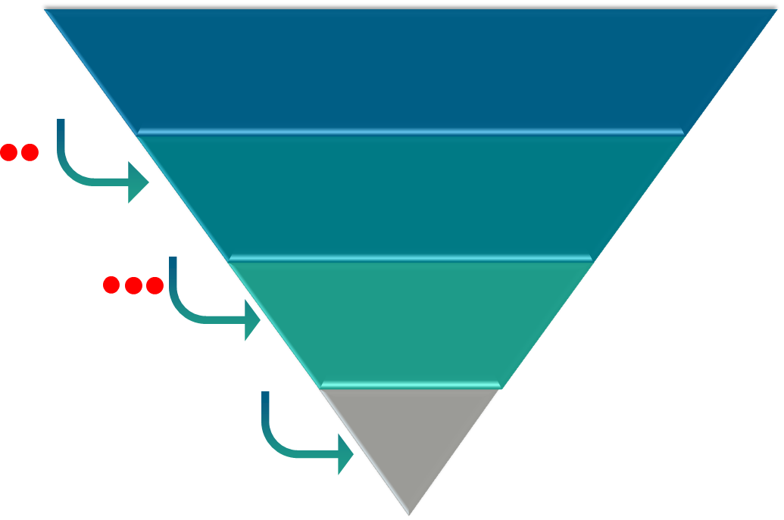
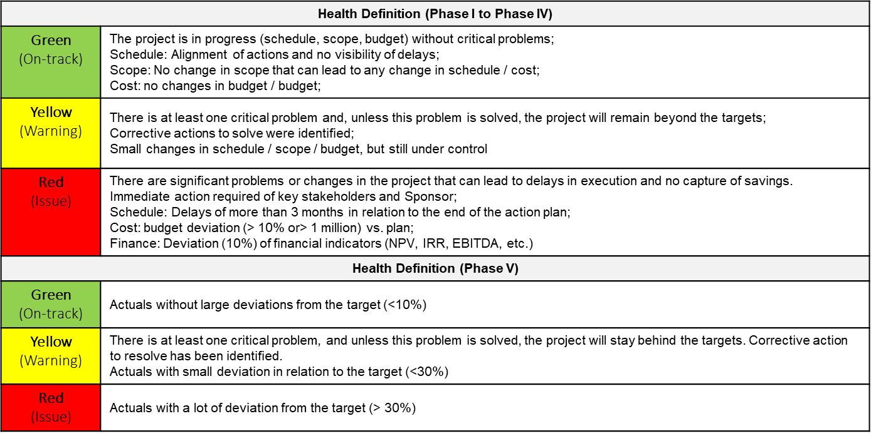

Portfolio Reviews at different levels – Details
Escalation Levels
Process
PMs should leverage project health status and follow the definition from PPM to identify projects with issue;
The person responsible for each level should escalate to next level as appropriate based on escalation criteria identified by the PRT. Normally escalation happens when there is a risk related to schedule, cost, finance targets and it is not possible to solve internally;
Some businesses use the following approach: 2 weeks in a row with critical projects health stated as “red” is the appropriate time to escalate the issue and ask from help to next level ( from Workstream to Business Meeting). If the issue remains for one more week probably there is a reason to escalate to next level and so on.
Project team level
PM responsible to escalate to functional level
(Finance, safety, engineering, etc…)
Functional Level
PMO responsible to escalate to business
Business level
LT responsible for decision
© 2021 Cargill, Incorporated. All rights reserved.
11

Slide 12
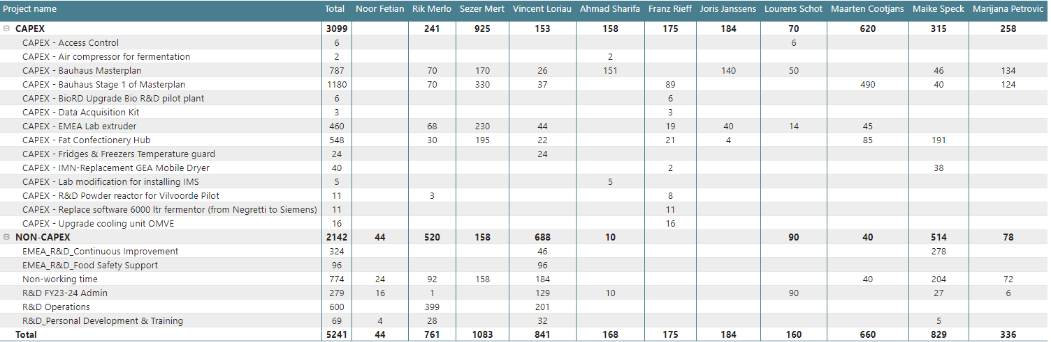
myPPM timesheets FY25 –YTD September
Resource planning

